Slide 1
Death Rates, Pharmaceutical Sales, and Pfizer Stock: A Correlational Analysis
AI Boot Camp Project 1
Team Members:
Rebecca Carr
Ronak Dsouza
Jesse Gunter
Tanya Soriano

Slide 2
Project Overview
Project Purpose / Description
This research aims to explore the potential interconnections between death rates in the United States and two key variables: pharmaceutical sales and Pfizer stock prices. By analyzing these variables over time, we seek to identify any correlations or patterns that may suggest relationships between public health outcomes, medical technology trends, and pharmaceutical industry performance.

Slide 3
Project Overview
Goals/Questions to be addressed
Determine if U.S. death rates correlate with drug sales.
Determine if U.S. death rates correlate with Pfizer stock closing price.
Are there seasonal patterns in drug sales, death rates and Pfizer stock?
Determine best time of year to buy Pfizer stock.

Slide 4
Project Overview
Overview of data collection, cleanup and exploration process
Data was obtained from reliable sources. Death rate statistics were sourced from the Centers for Disease Control and Prevention (CDC), a leading public health agency. Pharmaceutical sales data was acquired from Kaggle, a trusted platform for data scientists. Historical Pfizer stock prices were retrieved from Marketwatch, a prominent financial news and data provider.
We initiated the data cleaning process by thoroughly examining the datasets. We focused on 4 datasets:
1. Death rates in the United States
2. Pharmaceutical sales data
3. Pfizer stock prices 2021
4. Pfizer stock price 2022

Slide 5
Approach taken to achieve goals
Project Overview
Our initial focus was on ensuring data consistency and alignment. We standardized the date/time formats across all datasets to facilitate merging.
Data cleaning was a crucial step. We identified and removed missing values, addressed duplicate entries and tackled any issues with inconsistent data types. We also renamed columns for clarity.
Next, we continued our analysis by grouping data utilizing the groupby method where we deemed appropriate, for example in the such as by disease types.
Additionally, we renamed columns for clarity and grouped data where appropriate, for example by disease types. We worked to ensure each data frame was ready for further analysis through merging.
Next, we merged data frames to continue our exploratory data analysis and see if there are any relevant correlations. We used functions like concat and corr. Finally, we used the plot function to generate data visualizations and identify seasonal trends.
We investigated if the data revealed specific diseases and a correlation with specific drugs, but realized this was not appropriate as Pfizer stock is not specific to the individual type of drugs manufactured, but to the company as a whole.
Ultimately, the strongest correlation was drug sales total and death counts total.

Slide 6
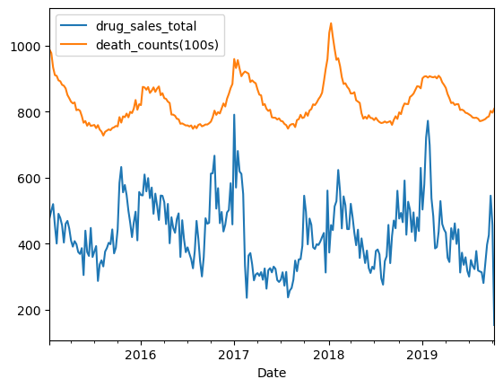
Result/Conclusion 1
Provide a summary of the results with the supporting visualizations (at least 2 per question)
Correlation between total drug sales and total death counts. Correlation coefficient of 0.423

Slide 7
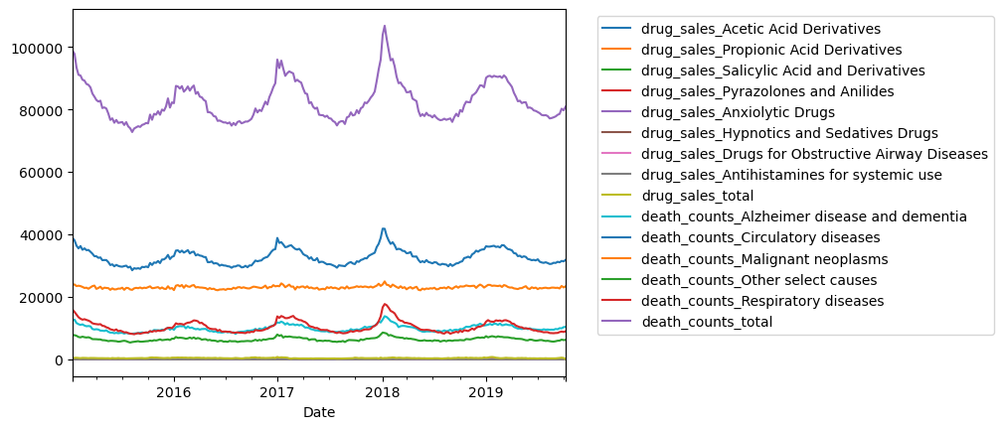
Result/Conclusion 1
Initial data visualization

Slide 8
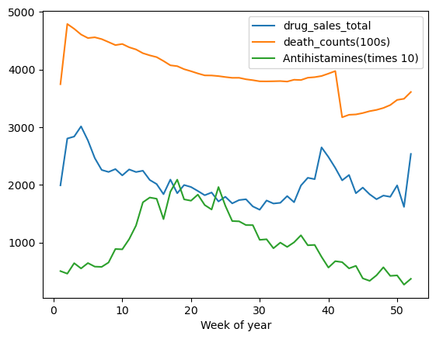
Result/Conclusion 2
Provide a summary of the results with the supporting visualizations (at least 2 per question)
Overall drug sales and death counts seem to seasonally be higher in the winter. Antihistamines are an exception and are higher in the spring/summer.

Slide 9
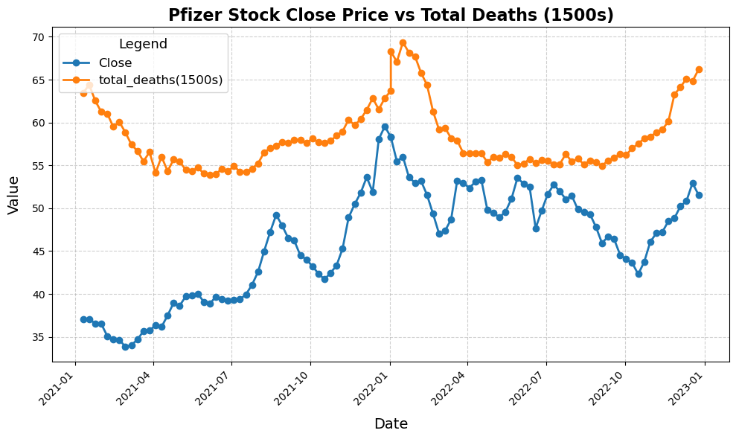
Correlation between Pfizer closing price and total death rates. Correlation coefficient of .384
Result/Conclusion 3

Slide 10
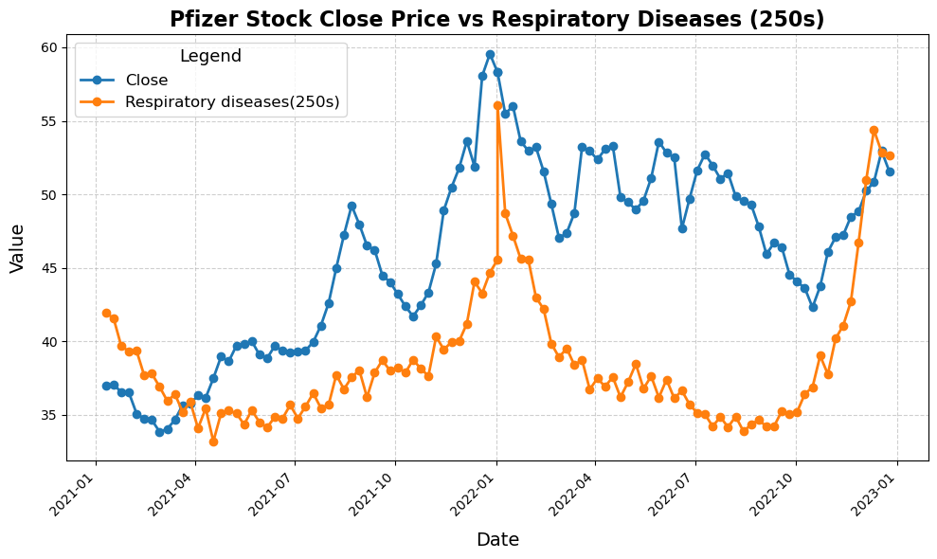
Correlation between Pfizer closing price and respiratory death rates. Correlation coefficient of .464
Result/Conclusion 3

Slide 11
There is a positive correlation between death rates and drug sales: when death rates increase, pharmaceutical sales increase.
Death rates are higher in winter, and therefore, so are pharmaceutical sale. However, the data suggests antihistamines are an exception. This could be due to summer allergies or other unknown factors.
There is a positive correlation between death rates and Pfizer stock prices. The correlation coefficient increases when filtered to respiratory diseases.
Implications:
Better to buy Pfizer in the summer and sell in the winter.
Pharmaceutical companies should consider manufacturing and logistics timelines to for profitability.
Summary

Slide 12
Sourcing data with the necessary details was difficult, as many sources used excessive medical terminology.
Some data did not have enough documentation.
Trouble finding data that matched timeframe?
What code to use to produce the best result.
Working with GitHub and multiple branches
Problems Encountered

Slide 13
Summarize any additional questions that surfaced, what your group might research next if more time was available, or share a plan for future development.
Performing this same study but with longer timeframes of data to detect patterns and trends.
Lining up all 3 datasets
Exploring post-COVID-19 pandemic deaths that are not directly attributed to COVID.
Future Considerations

